Slide 1
CTE & Temp Tables in SQL
SQL Day 1 Class

Slide 2
Learning Objectives
By the end of this lesson, you will be able to:
Understanding TEMP Tables:
Learn the concept and purpose of TEMP tables in SQL.
Differentiate TEMP tables from permanent database tables.
Explore how TEMP tables can simplify and streamline complex data processing tasks.
Understanding CTEs:
Learn the concept and purpose of TEMP tables in SQL.
Differentiate TEMP tables from permanent database tables.
Explore how TEMP tables can simplify and streamline complex data processing tasks.

Slide 3
Defining a Common Table Expression

Slide 4
What is a CTE
CTEs are a temporary result set that you can reference within a SELECT statement..
Simplify complex SELECT queries and improve readability.
CTEs are not stored in the database and exist only during the execution of a query.
Enhances query structure by allowing you to define intermediate results within the SELECT statement itself.
Notes:
Speaker Notes:
Welcome to the section on "Introduction to Temporary Tables."
In this segment, we'll explore the fundamental concept of temporary tables and their significance in SQL.
Temporary tables are like ephemeral workspaces in SQL, serving as dynamic data storage during query execution.
It's crucial to distinguish them from permanent database tables, as they have a limited lifespan within a session.
We'll delve into how temporary tables streamline complex data tasks and optimize SQL queries. Understanding their role is pivotal for efficient data manipulation and analysis. Let's continue our journey into the world of temporary tables.

Slide 5
What is a TEMP TABLE
A CTE is a named query expression that is defined within the execution scope of a single SQL statement.
Characteristics:
Temporary: Exists only during the execution of the statement.
Readable: Enhances the clarity and maintainability of complex queries.
Recursive: Can be used to write recursive queries, which are useful for hierarchical data.
Usage: Ideal for simplifying complex joins and subqueries.

Slide 6
Creating CTEs

Slide 7
Creating a CTE
Creating Temporary Tables Using WITH Clause
WITH Clause: Used to define a CTE, establishing a temporary result set within a SELECT statement.
Specify the columns and expressions in the CTE definition.
The SELECT query within the CTE produces a result set that can be referenced later in the query.

Slide 8
Creating a CTE
Syntax:
WITH CTE_Name AS (
SELECT Column1, Column2, ...
FROM TableName
)
SELECT *
FROM CTE_Name;
Explanation:
WITH CTE_Name AS (...): Begins the definition of a Common Table Expression (CTE) named CTE_Name.
SELECT * FROM CTE_Name: Uses the CTE defined earlier, retrieving all columns (*) from the temporary result set created by CTE_Name.

Slide 9
Creating a TEMP Table
Example:
Create a temporary table named "#temp_employees" to store the data of employees who joined the company after a certain date:
WITH RecentEmployees AS (
SELECT employee_id, first_name, last_name, hire_date
FROM employees
WHERE hire_date >= '2023-01-01'
)
SELECT *
FROM RecentEmployees;

Slide 10
Creating a TEMP Table
CTEs are temporary result sets that you create using the WITH clause in a query.
Why Use CTEs?
Easier to Read: CTEs make complex queries simpler and easier to understand.
Temporary Use: They only exist while your query runs, so they won't affect other queries.
No Extra Cleanup: You don't need to worry about deleting them—they disappear after the query finishes.

Slide 11
Defining a Temp Table

Slide 12
What is a TEMP TABLE
Temporary tables serve as dynamic and session-specific data storage within SQL.
Temporary vs. Permanent: Temporary tables are distinct from permanent database tables and are designed for short-term needs.
Session Scope: They exist only for the duration of a user session, automatically vanishing when the session ends.
Data Manipulation: Temporary tables provide a convenient way to stage, process, and analyze data during SQL query execution.
Notes:
Speaker Notes:
Welcome to the section on "Introduction to Temporary Tables."
In this segment, we'll explore the fundamental concept of temporary tables and their significance in SQL.
Temporary tables are like ephemeral workspaces in SQL, serving as dynamic data storage during query execution.
It's crucial to distinguish them from permanent database tables, as they have a limited lifespan within a session.
We'll delve into how temporary tables streamline complex data tasks and optimize SQL queries. Understanding their role is pivotal for efficient data manipulation and analysis. Let's continue our journey into the world of temporary tables.

Slide 13
What is a TEMP TABLE
Temporary tables can be created directly from SQL queries, allowing for dynamic data generation.
SQL query results can be stored in a temporary table for further analysis and manipulation.
Let's explore how to create temporary tables from queries to facilitate complex data processing.
Notes:
Speaker Notes:
In SQL, you can create temporary tables directly from query results, offering a powerful way to generate and work with data dynamically.
This capability allows us to store the output of a query into a temporary table, providing a structured format for further analysis or manipulation.
In the following slides, we'll delve into practical examples of creating temporary tables from queries and leveraging this approach to tackle complex data tasks.

Slide 14
Creating TEMP Tables

Slide 15
Creating a TEMP Table
Creating Temporary Tables Using INTO Clause
The SELECT INTO statement creates a temporary table from a query result.
You specify the desired columns and data types in the SELECT clause.
The query results are inserted into the temporary table defined in the INTO clause.
Notes:
Speaker Notes:
In addition to using the CREATE TEMPORARY TABLE statement, you can create temporary tables using the SELECT INTO statement.
With the SELECT INTO statement, you define the structure of the temporary table within the SELECT clause, specifying the desired columns and their data types.
The query results are then inserted into the temporary table defined in the INTO clause, simplifying the process of creating and populating temporary tables in SQL.

Slide 16
Creating a TEMP Table
Syntax:
SELECT column1, column2, ...
INTO #temporary_table_name
FROM source_table
WHERE condition
Explanation:
SELECT column1, column2, ...: Specifies the columns to include in the temporary table, selected from the source table or query results.
INTO #temporary_table_name: Indicates the creation of a temporary table with the specified name (# prefix denotes its temporary nature).
Notes:
Speaker Notes:
In this section, we'll delve into the powerful SQL technique of creating temporary tables from queries.
This approach provides us with a dynamic workspace for data processing and analysis.
Let's start by looking at the syntax for creating temporary tables from queries, followed by a detailed explanation.
The process begins with the CREATE TEMPORARY TABLE statement, where we specify the name of our temporary table. This name should be unique within the session and can have a prefix to indicate its temporary nature.
The AS keyword tells SQL that the query results will populate our temporary table.
Inside the SELECT statement, we define the columns we want in the temporary table, either by specifying them individually or using a wildcard (*) to include all columns.
The FROM clause identifies the source table or query from which we'll extract data.
Optionally, we can use the WHERE clause to filter the data based on specific conditions.
The result is a temporary table that offers a structured workspace for further data analysis and manipulation within the current session.
Remember that temporary tables are automatically removed when the session ends, making them an excellent choice for short-term data processing needs.

Slide 17
Creating a TEMP Table
Example:
Create a temporary table named "#temp_employees" to store the data of employees who joined the company after a certain date:
SELECT employee_id, first_name, last_name, hire_date
INTO #temp_employees
FROM employees
WHERE hire_date >= '2023-01-01’;
Notes:
Speaker Notes:
Let's put the concept of creating temporary tables using the INTO clause into practice with an example.
In this SQL query, we aim to create a temporary table named "#temp_employees."
We start with the SELECT statement, where we define the columns we want to include in our temporary table. These columns are selected from the "employees" table.
What's unique here is the use of the INTO clause, followed by the name of the temporary table (#temp_employees). The "#" prefix signifies that it's a temporary table.
Our query specifies the source table ("employees") from which we extract the data.
Additionally, we apply a filtering condition in the WHERE clause to include only employees hired on or after January 1, 2023.
The outcome is a session-specific temporary table, ready for further analysis and reporting, and it will be automatically removed when the session concludes.

Slide 18
Creating a TEMP Table
Use of Temporary Tables (#) in SQL
Temporary tables in SQL are denoted with a # symbol before the table name.
They serve several essential purposes in data analysis and query processing.
Key Benefits of Using Temporary Tables:
Scope Isolation: Temporary tables are session-specific, ensuring data isolation and preventing interference with other sessions or queries.
Automatic Cleanup: They are automatically dropped when the session ends, reducing the need for manual cleanup.
Notes:
Temporary tables, marked with a #, are invaluable in SQL for data analysis and query processing. They offer a distinct scope, automatic cleanup, and isolation. These benefits make them ideal for storing and manipulating data temporarily during a session. Temporary tables can improve query performance and reduce naming conflicts while maintaining data integrity. In our guided exercise, we used them to break down complex data analysis tasks into manageable steps.

Slide 19
Creating a TEMP Table
Use INTO Clause When:
Quick Data Extraction: Extract and work with data swiftly without table structure definition.
Simplified Syntax: Create temporary tables effortlessly without specifying column details.
Ad Hoc Queries: Convenient for one-time data processing tasks.
Intermediate Result Storage: Practical for storing intermediate results during queries or scripts.
Notes:
Speaker Notes:
Let's delve deeper into the scenarios when utilizing the INTO clause for temporary tables makes the most sense.
First, when you require quick data extraction from a single query without defining the table structure in advance, the INTO clause shines. It simplifies the process, making it both swift and efficient.
Second, if your goal is to create a temporary table with a straightforward syntax, skipping the explicit definition of column names and data types, the INTO clause streamlines this task.
For ad hoc queries or one-time data processing tasks where the temporary table won't be reused, the INTO clause provides a convenient and concise solution.
Lastly, when you need to store intermediate results during query or script execution, the INTO clause serves as a practical choice for temporary data storage.

Slide 20
Data Analysis with TEMP Tables

Slide 21
Data Analysis with Temp Tables
The INTO clause extends beyond creating temporary tables; it's a versatile tool for deconstructing complex data analysis tasks into manageable stages.
Notes:
Speaker Notes:
In this slide, we'll explore the remarkable versatility of the INTO clause. It's not merely a tool for creating temporary tables; it's a powerful asset for breaking down intricate data analysis into more manageable steps. Let's dive in.

Slide 22
Data Analysis with Temp Tables
Step 1: Begin by using the INTO clause to extract raw data into a temporary table.
Extract raw data into a temporary table:
SELECT *
INTO #RawData
FROM YourSourceTable
WHERE SomeCondition;
Notes:
Speaker Notes:
In the first step of leveraging the INTO clause for intermediate data analysis, we use it to both create a temporary table, denoted here as #FilteredData, and insert data into it. This single step allows us to extract raw data from your source table and apply initial filters or conditions to refine the dataset, ensuring that we work with relevant information. This initial filtering sets the stage for more focused analysis.

Slide 23
Data Analysis with Temp Tables
Step 2: Temporary tables can store intermediate results, allowing you to perform data transformations and clean up data.
Remove Duplicates with Temporary Tables:
SELECT DISTINCT Col1, Col2, Col3
INTO #IntUniqueRecords
FROM #FilteredData;
Notes:
Speaker Notes:
In the second step of leveraging the INTO clause for intermediate data analysis, we focus on creating intermediate results specifically for data cleaning. We use the INTO clause to create temporary tables that help us organize and structure our cleaning process.
Here, in the example:
We create a temporary table #UniqueRecords where we focus on removing duplicate records from the SourceTable.
The SELECT DISTINCT statement is employed to ensure only unique combinations of columns (Col1, Col2, Col3) are selected.
This operation effectively cleans the data by eliminating duplicate entries, ensuring that our dataset contains only distinct records.

Slide 24
Data Analysis with Temp Tables
Step 3: Leverage intermediate results, including the joined data, for the final analysis.
Perform advanced analysis or reporting to derive meaningful insights:
SELECT Col1,
AVG(Col2) AS MaxTValue,
MAX(TransformedValue) AS MaxTValue
FROM #IntUniqueRecords
GROUP BY Col1;
Notes:
Speaker Notes:
In the fourth and final step of leveraging the INTO clause for intermediate data analysis, we utilize the intermediate results, including the joined data stored in #FinalAnalysisData. This is where we perform advanced analysis.
In this example, we perform a final analysis by calculating the average of AverageValue and the maximum of TransformedValue grouped by Col1. This advanced analysis helps us derive meaningful insights from the structured and processed data, allowing us to make data-driven decisions and draw conclusions effectively.

Slide 25
Data Analysis with Temp Tables
Step 4: Dropping Temporary Tables
it's essential to manage them properly to maintain database performance and avoid clutter.
Drop Temp Table:
DROP TABLE #FinalAnalysisData;
Notes:
Speaker Notes:
Temporary tables are a valuable tool, but like any resource, they should be managed responsibly.
Dropping temporary tables when you're done with them is a good habit to maintain database performance and prevent clutter.
Including DROP TABLE statements in your scripts ensures script reusability and prevents conflicts with existing tables.
In production or collaborative environments, follow established cleanup practices and responsibilities to ensure database integrity.

Slide 26
Recap

Slide 27
Summary: CTEs and TEMP Tables
Common Table Expressions (CTEs):
Purpose: Simplify complex queries by breaking them into manageable parts.
Scope: Exist only within the execution of the query.
Temporary Tables:
Purpose: Store intermediate results for data processing and transformations.
Scope: Session-specific, automatically dropped when the session ends.
Notes:
Speaker Notes:
Intermediate data analysis brings a range of benefits to your data processing tasks. First, it promotes modularity by breaking down complex tasks into manageable steps. This simplifies the analysis process, making it easier to handle and maintain.
Additionally, working with intermediate results enhances efficiency. Since you're dealing with smaller datasets at each step, query execution is faster.
Clarity is another advantage. Each step is well-structured, making it easier to understand, share, and collaborate with others on your analysis.
Lastly, intermediate data analysis offers flexibility. You can easily modify or add new analysis steps to specific parts of your workflow, allowing you to adapt to changing requirements or explore additional insights.

Slide 28
Summary: CTEs and TEMP Tables
Choosing Between CTEs and Temporary Tables:
CTEs: Best for improving query readability and handling recursive queries.
Temporary Tables: Ideal for storing intermediate results and performing extensive data transformations.

Slide 29
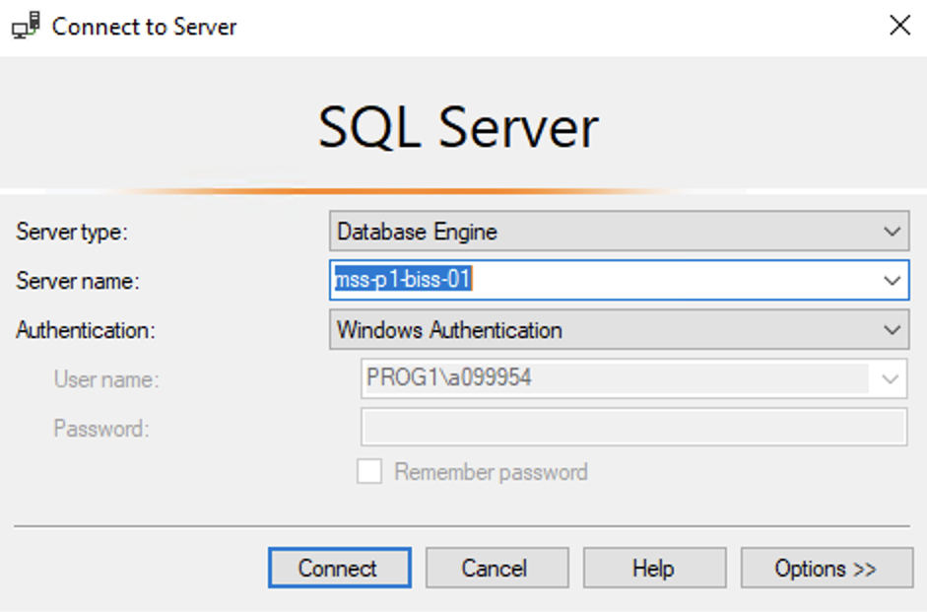
Hands On Examples
Using the AdventureWorks2012 Database
Please open up SSMS
Connect to BISS
Server = mss-p1-biss-01

Slide 30
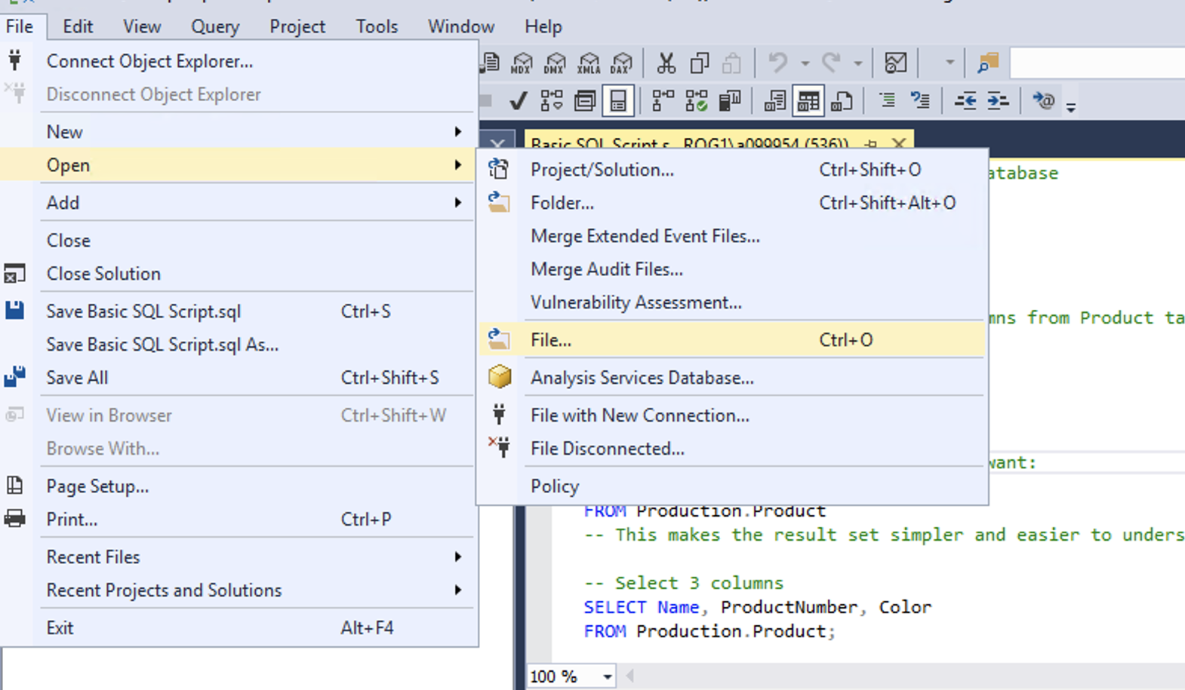
Hands On Examples
Click File -> Open -> File

Slide 31
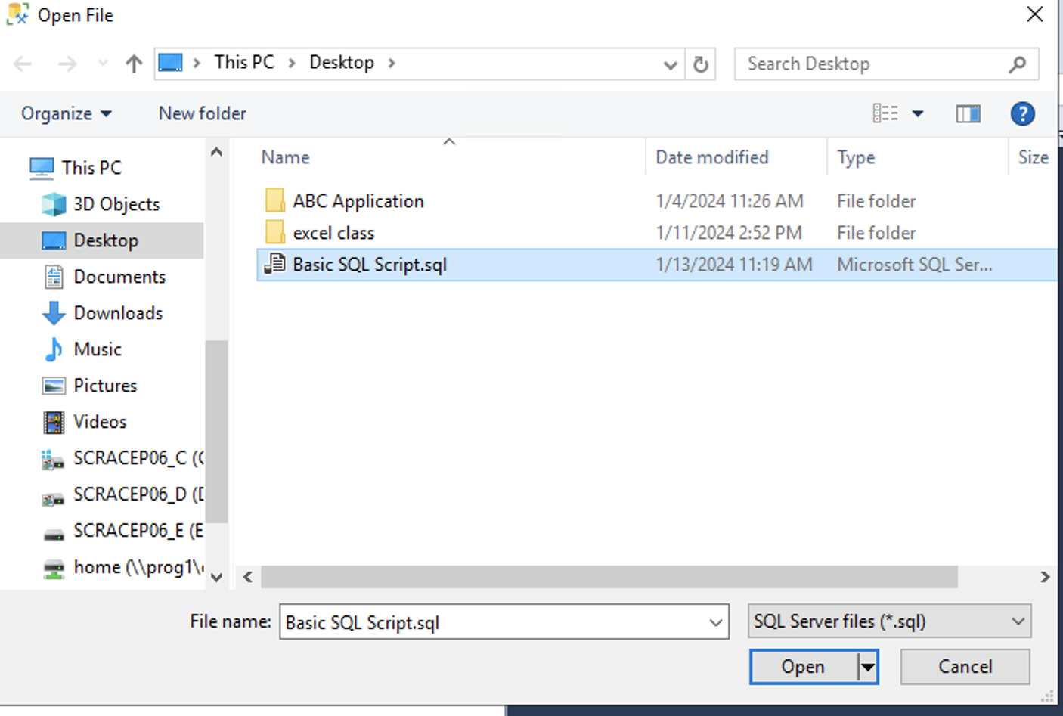
Hands On Examples
Open the TEMP Guided Script.sql file
Notes:
Walk through each function

Slide 32
Exercise
Open the Day 6 Exercise.sql file
Answer the questions from each section
Notes:
Answers are stored in the Exercise Answers.sql file

